Slide 1

Team Name : Vector Vanguard
Team Leader Name : Sri Sai Shivakoti
Problem Statement : Recruiters go through hundreds of profiles and still often miss the right person. Not because the talent isn't there — but because keyword filters can't see what actually matters.

Slide 2
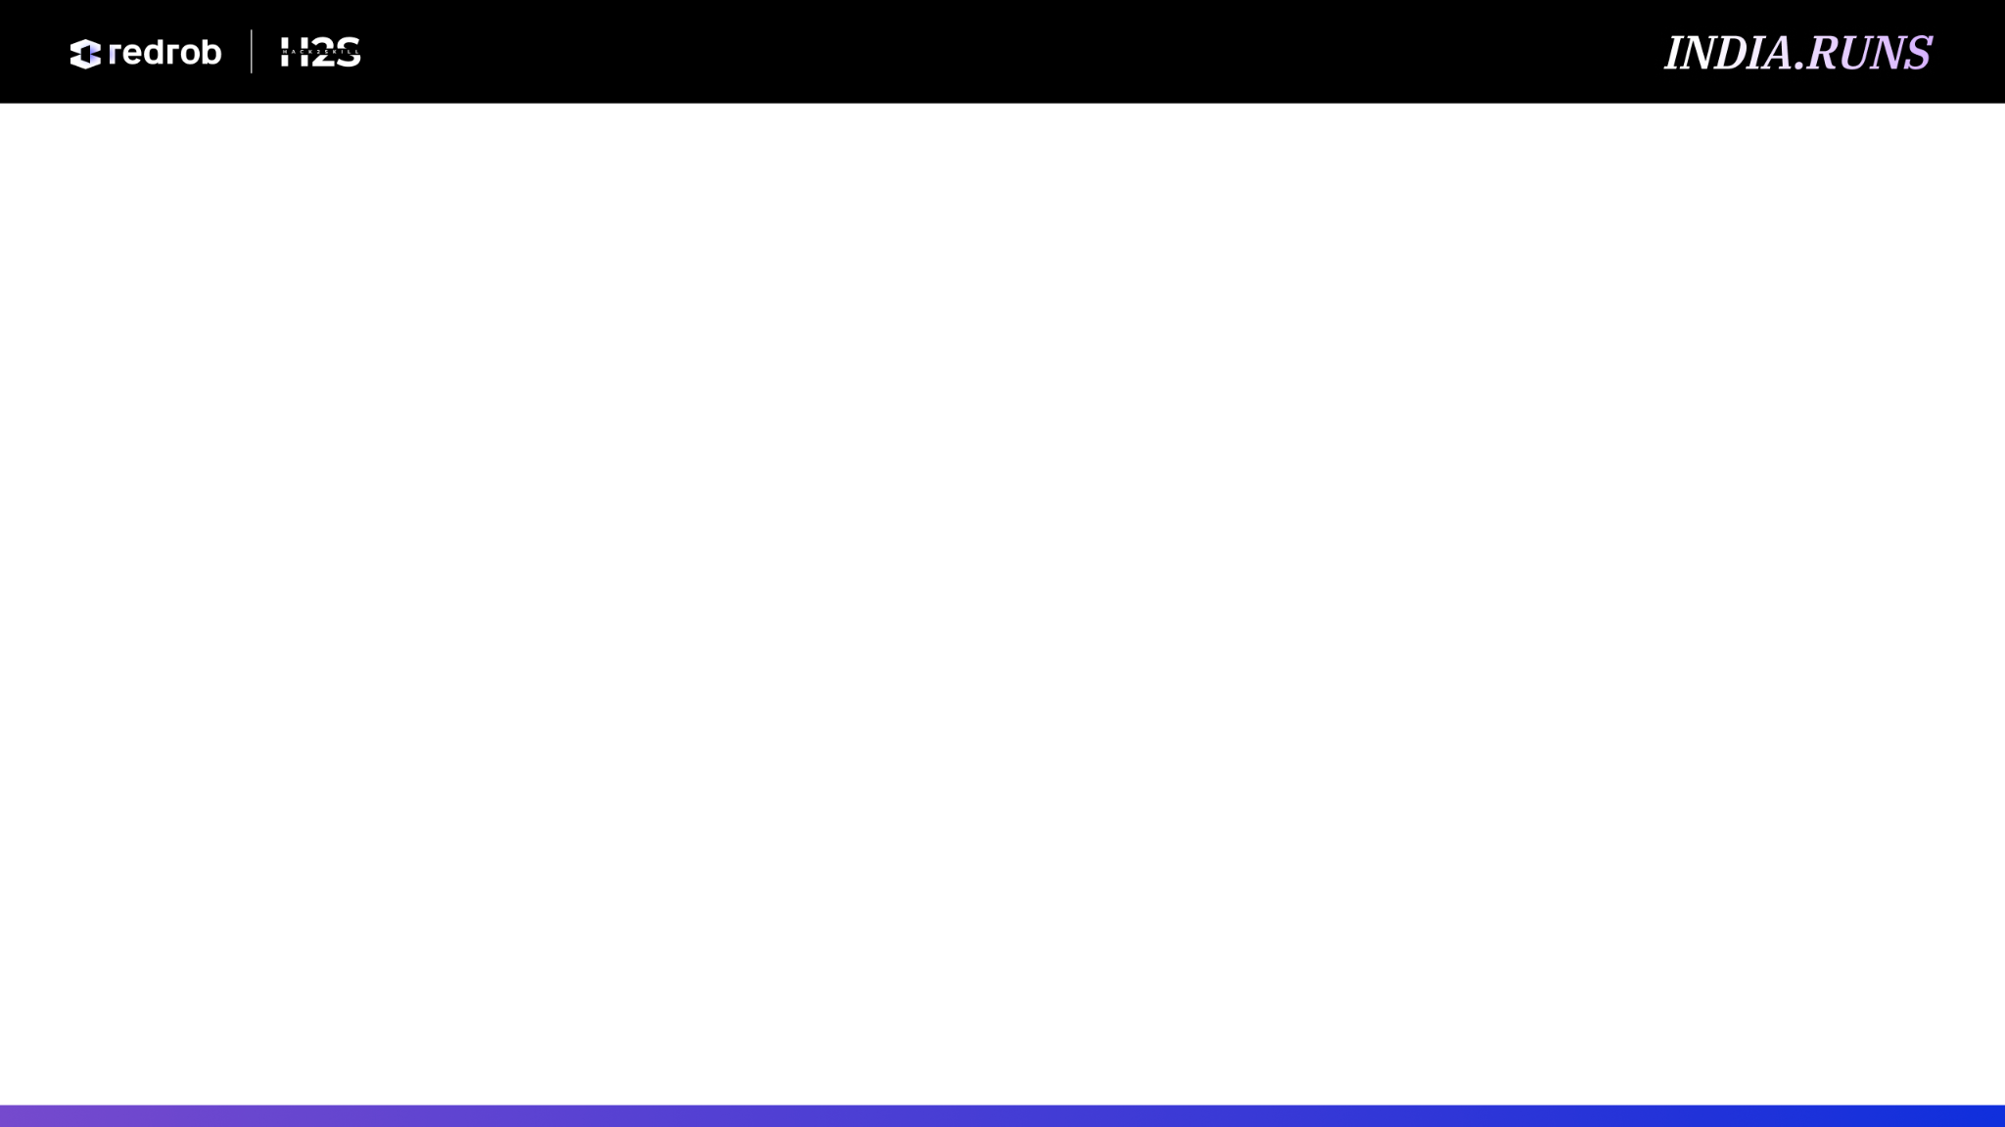
Solution Overview
Proposed Solution: I built a production-grade, state-managed recruiter portal AuraMatch that shifts candidate selection from manual keyword matching to deep semantic alignment.
Core Value Proposition: Traditional ATS systems miss candidates who built products but didn't list exact buzzwords. AuraMatch treats recruitment as a multi-dimensional graph and alignment problem.
Comprehensive Profiling: Evaluates career velocity (promotion speed, startup vs corporate experience), behavioral signals, knowledge graph expansions, and profile integrity diagnostics.

Slide 3
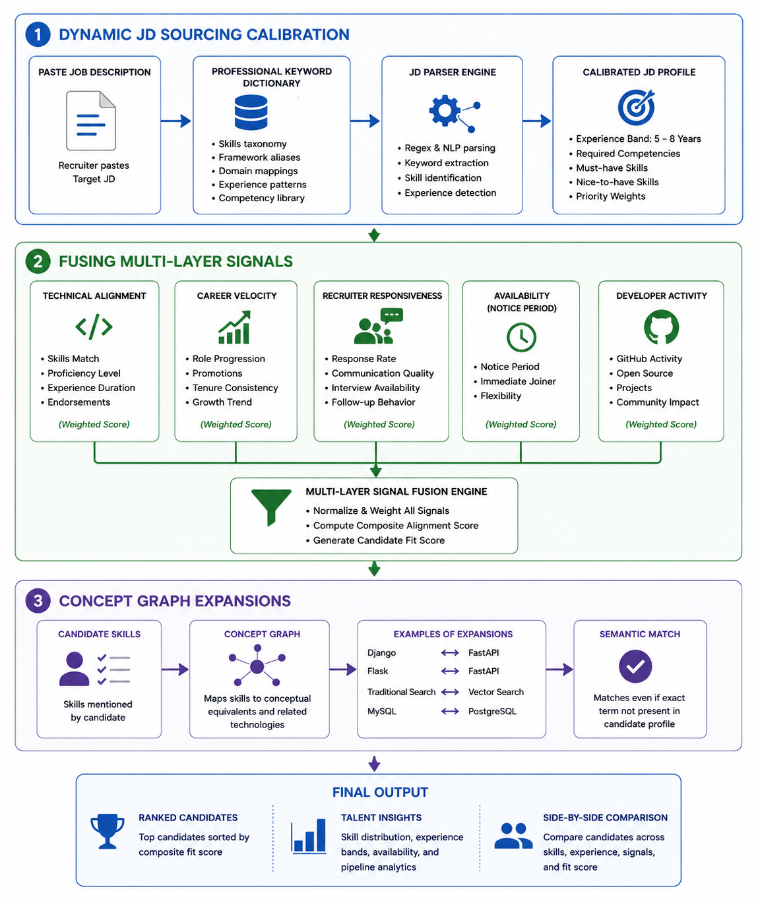
JD Understanding & Candidate Evaluation
Dynamic JD Sourcing Calibration: Pasting a Job Description automatically parses it using a comprehensive professional keyword dictionary to extract target experience bands (e.g. 5 to 8 years) and required competencies.
Fusing Multi-Layer Signals: Evaluates technical alignment (weighted by proficiency, duration, endorsements) combined with career velocity, recruiter responsiveness, availability (notice period), and developer activity.
Concept Graph Expansions: Identifies conceptual equivalents (e.g. mapping Django/Flask to FastAPI, or traditional search to modern vector search) even if the candidate did not list the exact term.

Slide 4
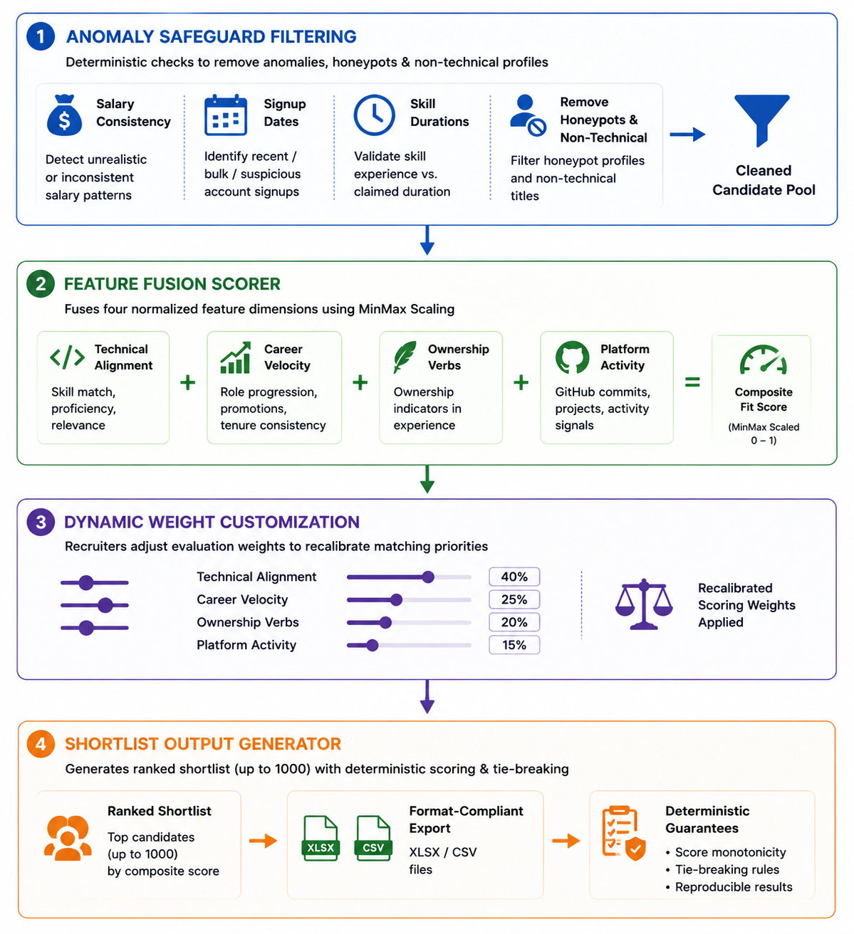
Ranking Methodology
Anomaly Safeguard Filtering: Pre-filters profiles by running deterministic checks on salary consistency, signup dates, and skill durations, removing honeypots and non-technical titles.
Feature Fusion Scorer: Fuses four normalized feature dimensions: Technical Alignment, Career Velocity, Ownership Verbs, and Platform Activity using MinMax Scaling.
Dynamic Weight Customization: Recruiters can adjust evaluation weight sliders to recalibrate matching priorities.
Shortlist Output Generator: Shortlists candidates (up to 1000 capacity) in format-compliant XLSX/CSV files with deterministic score monotonicity and tie-breaking.

Slide 5
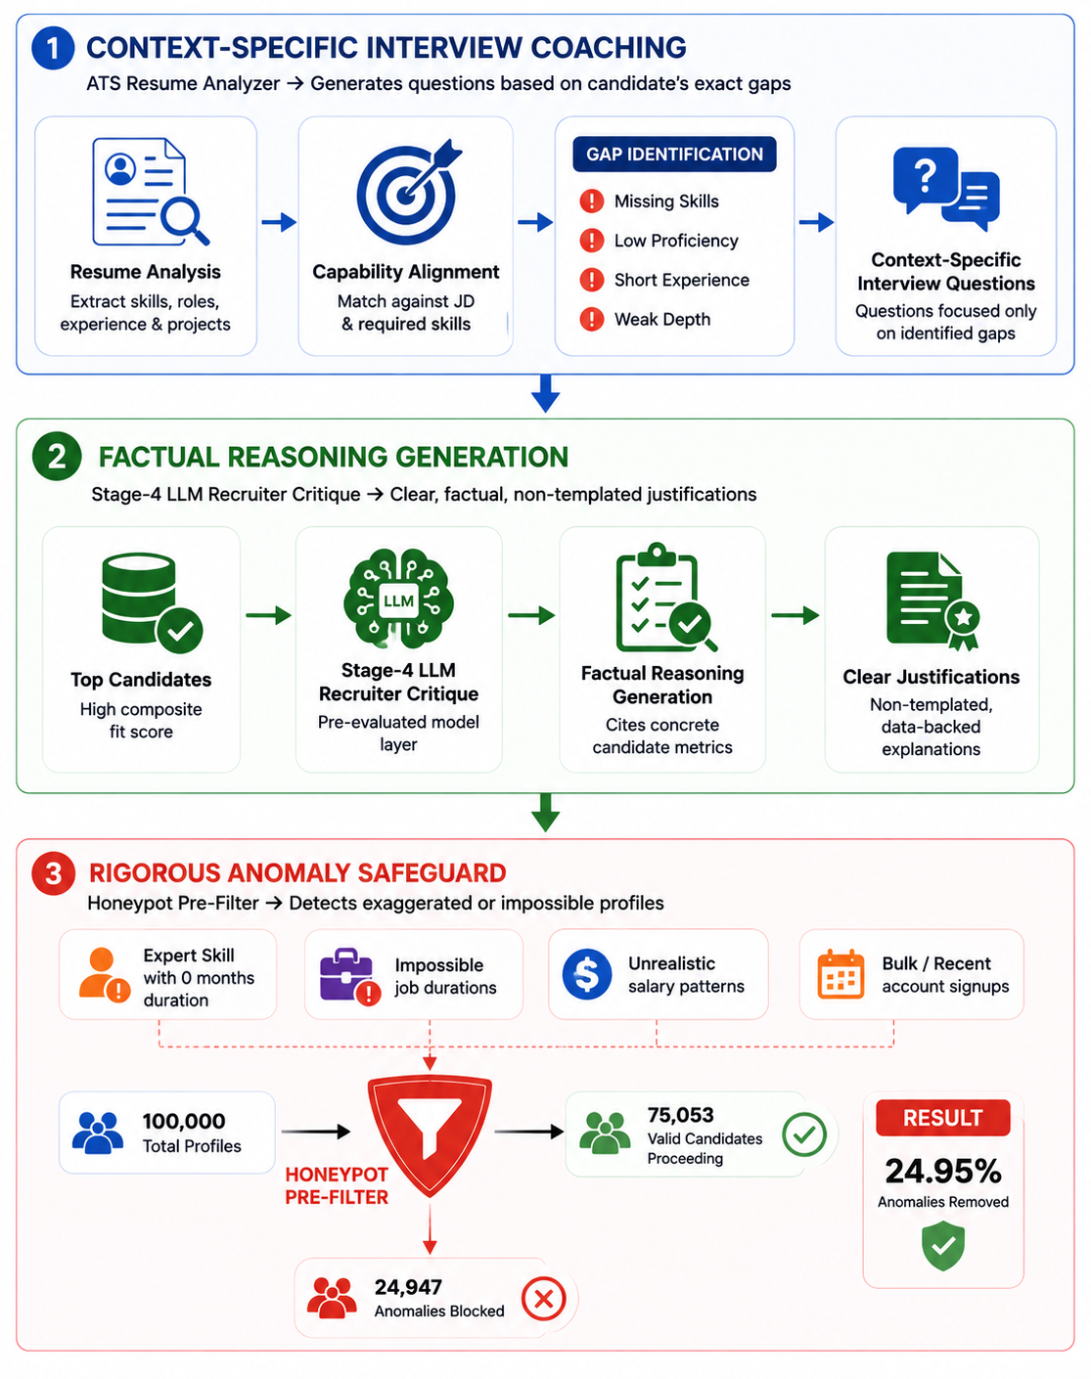
Explainability & Data Validation
Context-Specific Interview Coaching: The ATS Resume Analyzer analyzes capability alignment and automatically generates context-specific interview questions focused on the candidate's exact competency gaps.
Factual Reasoning Generation: Integrates a pre-evaluated Stage-4 LLM Recruiter Critique layer for top candidates, producing clear, non-templated justifications citing concrete candidate metrics.
Rigorous Anomaly Safeguard: The Honeypot Pre-Filter detects exaggerated profiles (e.g., expert proficiency with 0 months duration) or impossible job durations, blocking 24,947 anomalies out of 100,000 candidates.

Slide 6
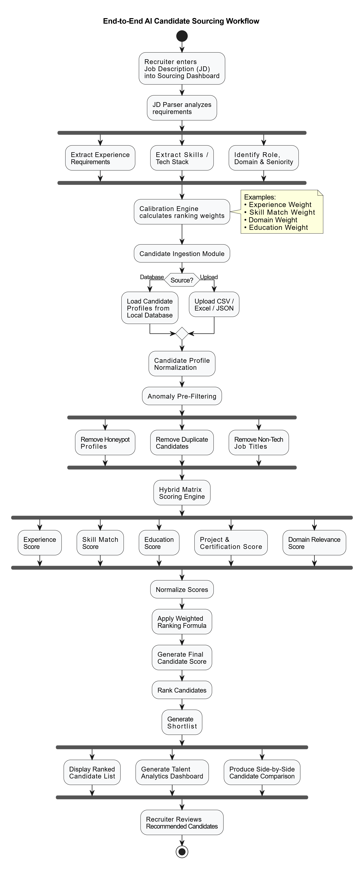
End-to-End Workflow
JD Input: Recruiter enters target JD into the sourcing dashboard.
Calibration: Sourcing parser extracts experience requirements and tech stacks, calibrating ranking weights.
Candidate Ingestion: Loads candidates (local database or custom CSV/Excel/JSON upload).
Anomaly Pre-Filtering: Deterministic filters remove honeypot profiles and non-tech titles.
Hybrid Matrix Scorer: Computes multi-dimensional scores and applies normalized weights.
Shortlist Delivery: Renders ranked shortlist, Talent Analytics, and Side-by-Side Comparison.

Slide 7
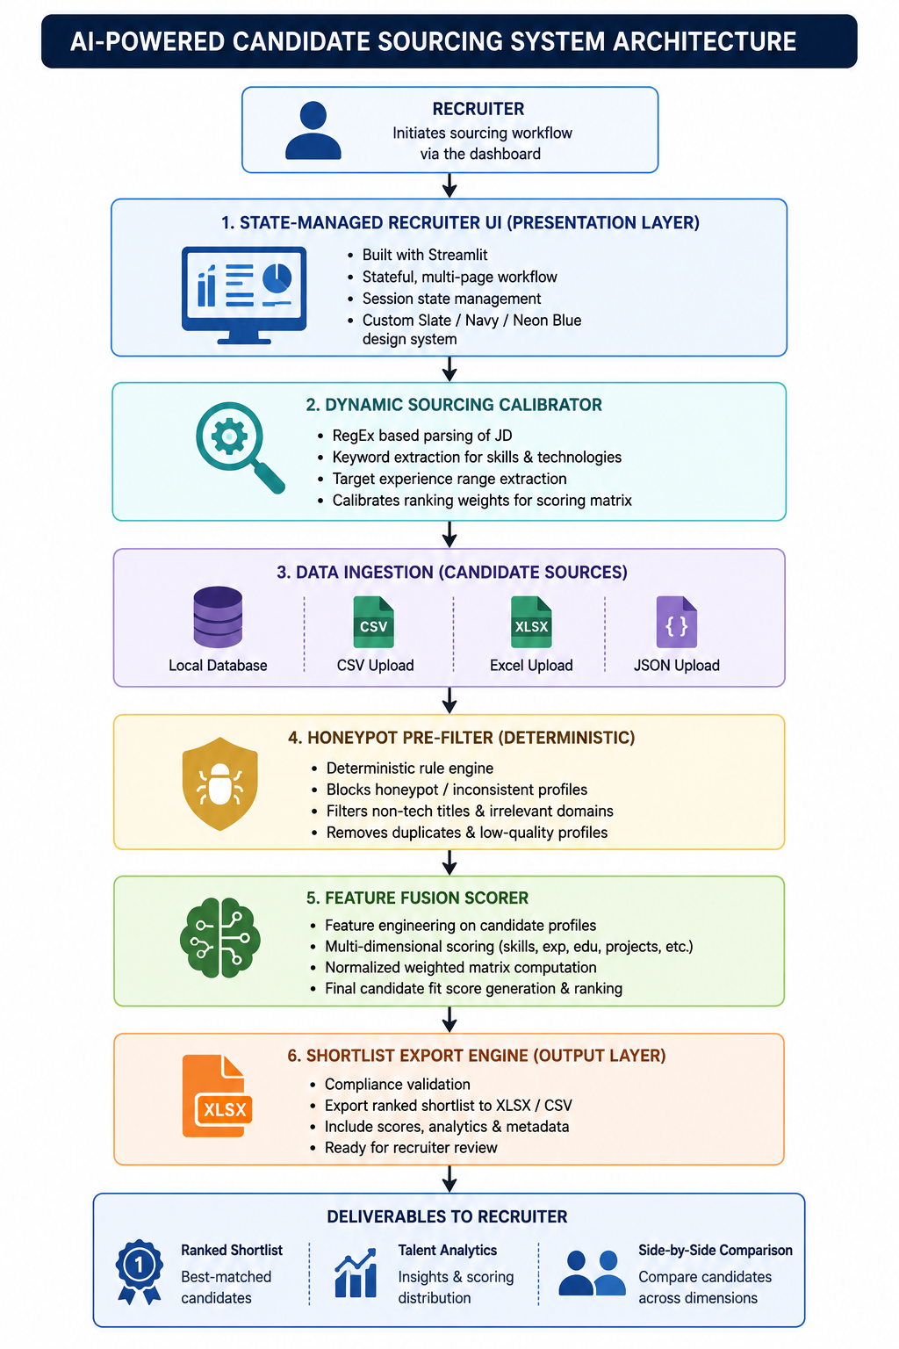
System Architecture
State-Managed Recruiter UI: Stateful, multi-page user interface built using Streamlit and styled with a custom Slate/Navy/Neon Blue design system.
Dynamic Sourcing Calibrator: RegEx and keyword extraction engine to calibrate target experience and skills.
Honeypot Pre-Filter: Deterministic checking rules blocking inconsistent profiles.
Feature Fusion Scorer: Normalized matrix engine computing candidate fit scores.
Shortlist Export Engine: Generates compliance-validated XLSX/CSV candidate shortlists.

Slide 8
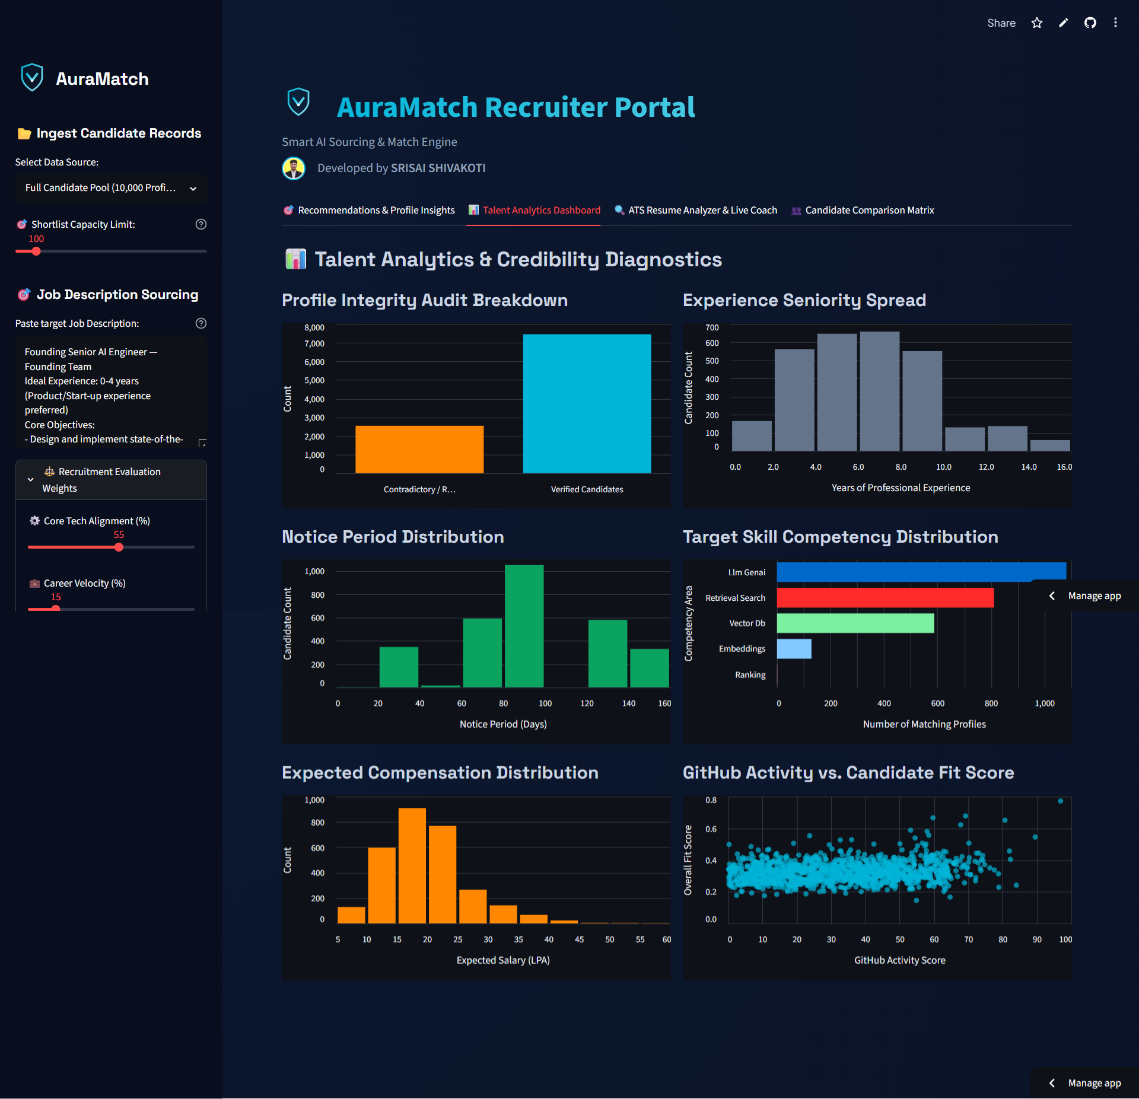
Results & Performance
Sub-8 Second Sourcing: AuraMatch processes, scores, and ranks 10,000 candidate profiles in under 8 seconds locally (CPU-only).
Cloud-Ready Efficiency: Uses Gzip-compressed datasets (5.2 MB) on Streamlit Community Cloud for instant page loads.
100% Anomaly Clean: Completely filters out honeypot profiles from the shortlist (zero anomalies in the top candidates).
Compliance Verified: Output files fully pass the challenge validation checker (validate_submission.py), ensuring correct score monotonicity and tie-breaking.

Slide 9
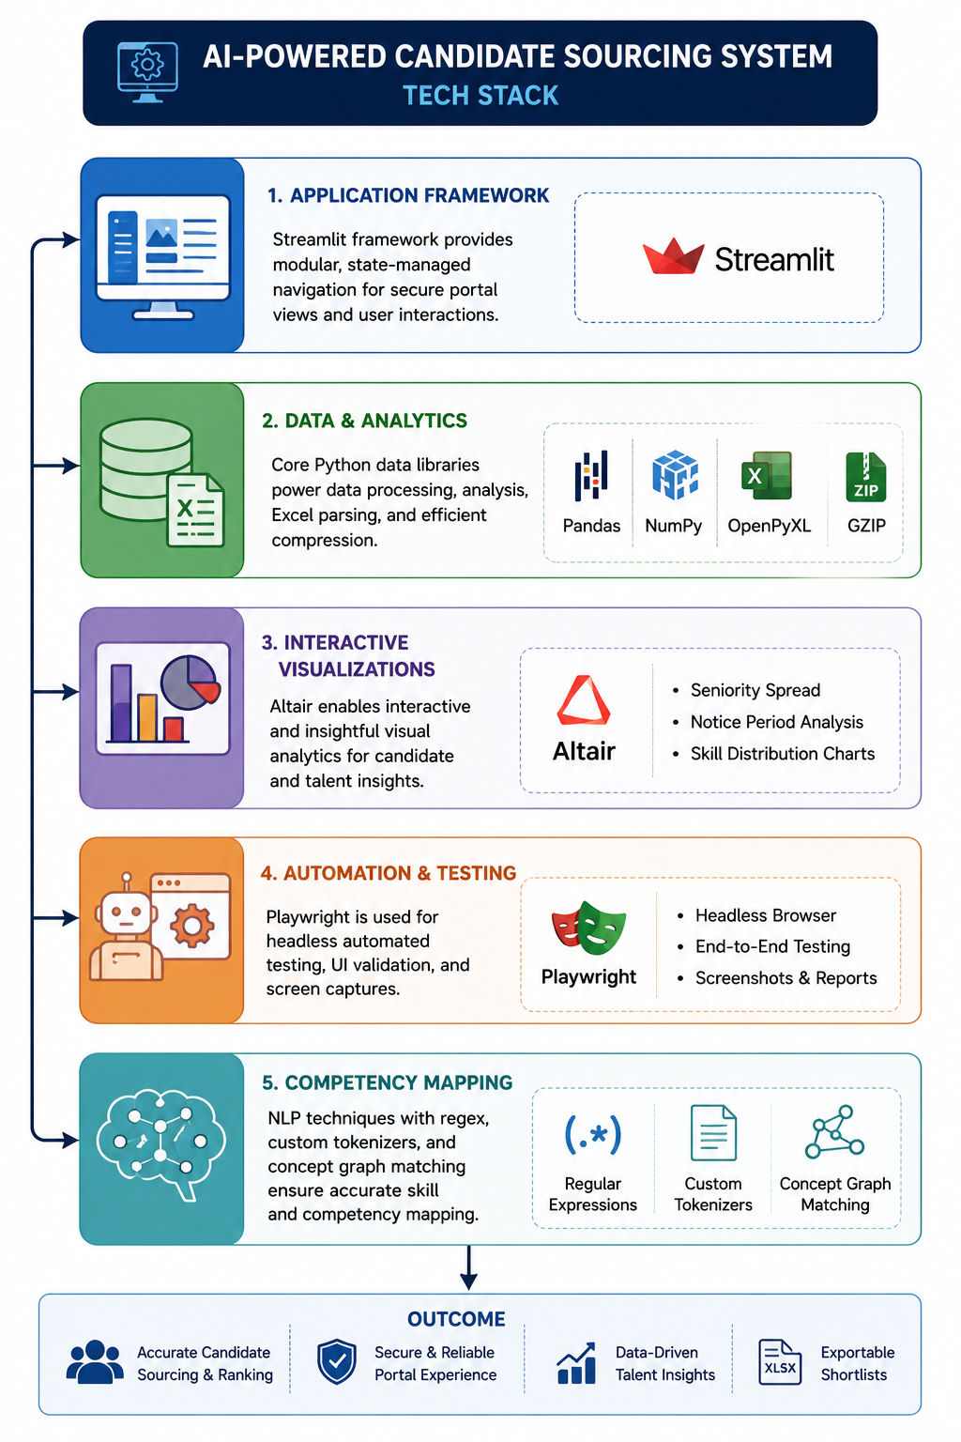
Technologies Used
Application Framework: Streamlit (modular state-managed navigation for secure portal views).
Data & Analytics: Pandas, NumPy, OpenPyXL, Gzip (efficient compression and Excel parsing).
Interactive Visualizations: Altair (seniority spread, notice period, and skill distribution charts).
Automation & Testing: Playwright (headless automated testing and screen captures).
Competency Mapping: Regular expressions, custom tokenizers, and concept graph matching.

Slide 10
Submission Assets
Live Web App URL: https://auramatch.streamlit.app/
GitHub Repository: https://github.com/Srisai16/IndiaRuns_Hack2Skill_AuraMatch
Submission Output: VectorVanguard.csv (100% compliant, fully validated candidate shortlist).
Final Presentation Deck: Idea Submission Template Redrob.pptx (outlining implementation, architecture, and results).
Candidate Sourcing Shortlist: AuraMatch_Top_100_Shortlist.xlsx

Slide 11


